Slide 1
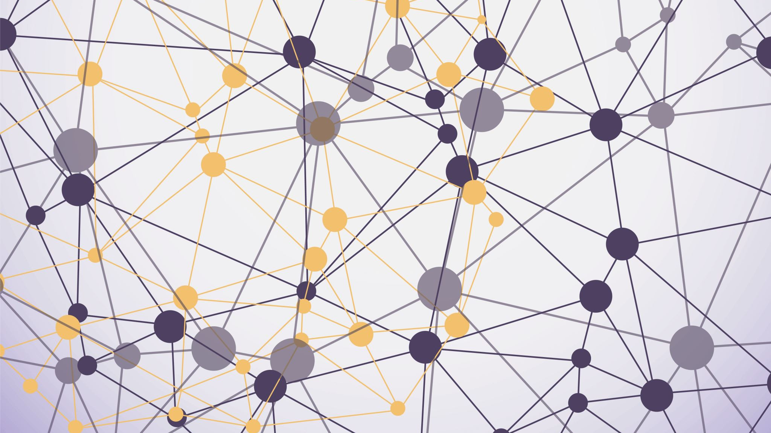
Deep Learning
Group 1 Final Project

Slide 2
Team Members:
Vinay Malik
Vani
Vikash Raj
Abeesh Thampi
Javid Sadr
Professor:
Babatunde Giwa

Slide 3

Project Description: i. The main objective of the project is to build and train a Convolutional Neural Network (CNN) to classify CIFAR images.
ii. CNN have ten or hundred of layers that each learn to detect different features of the images. The output of each convolved image is used as input to the next layer.

Slide 4
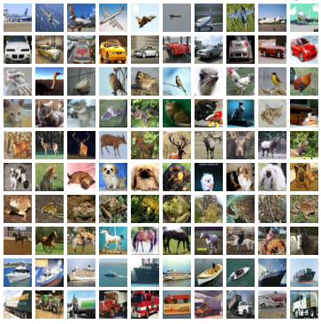
About CIFAR-10 Dataset
CIFAR-10 is a very popular computer vision dataset that is used in many deep learning research provided by the Canadian Institute For Advanced Research (CIFAR).
The number ‘10’ in CIFAR-10 represents the 10 classes used in the dataset which is represented as - Airplane, Automobile, Bird, Cat, Deer, Dog, Frog, Horse, Ship and Truck.
Dataset images are of color images with a (32 x 32) resolution.

Slide 5

Operations of CNN

Slide 6
Loading the Dataset
Reshaping the Data
Normalizing the Data
Steps Followed
Building the Model
Complying the Model
Training The Model

Slide 7
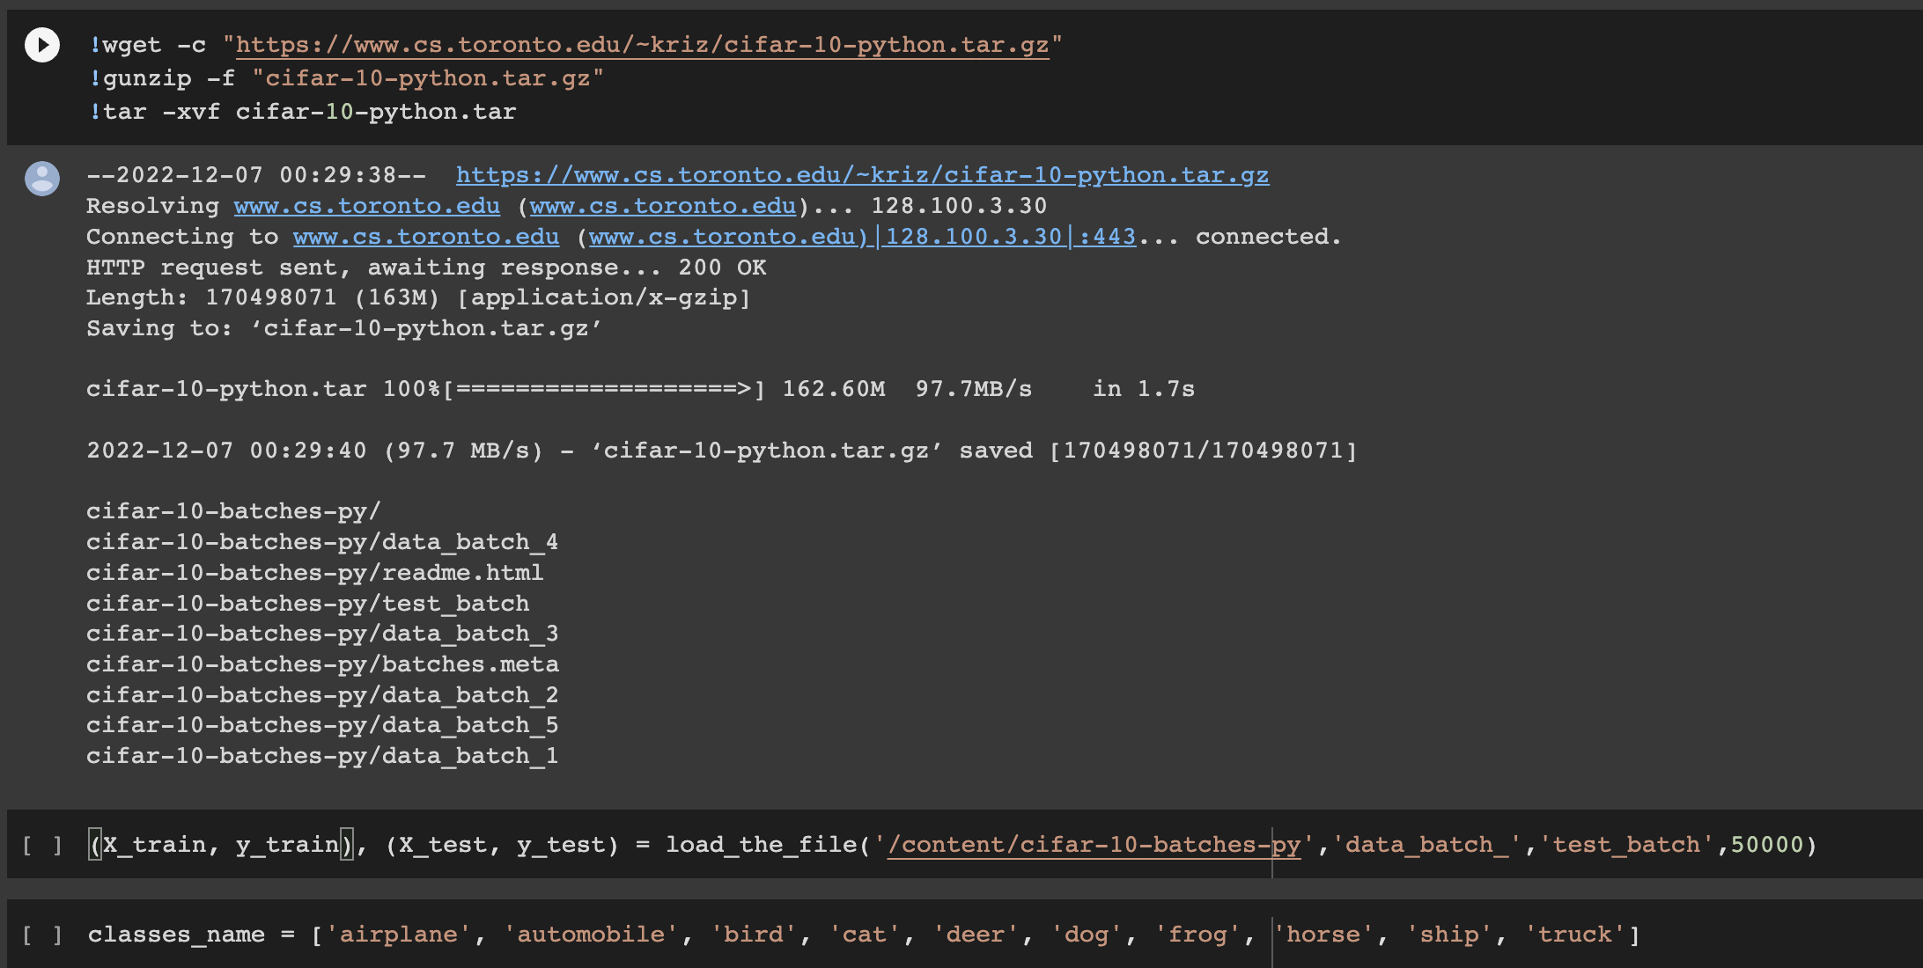
Loading the Dataset:

Slide 8
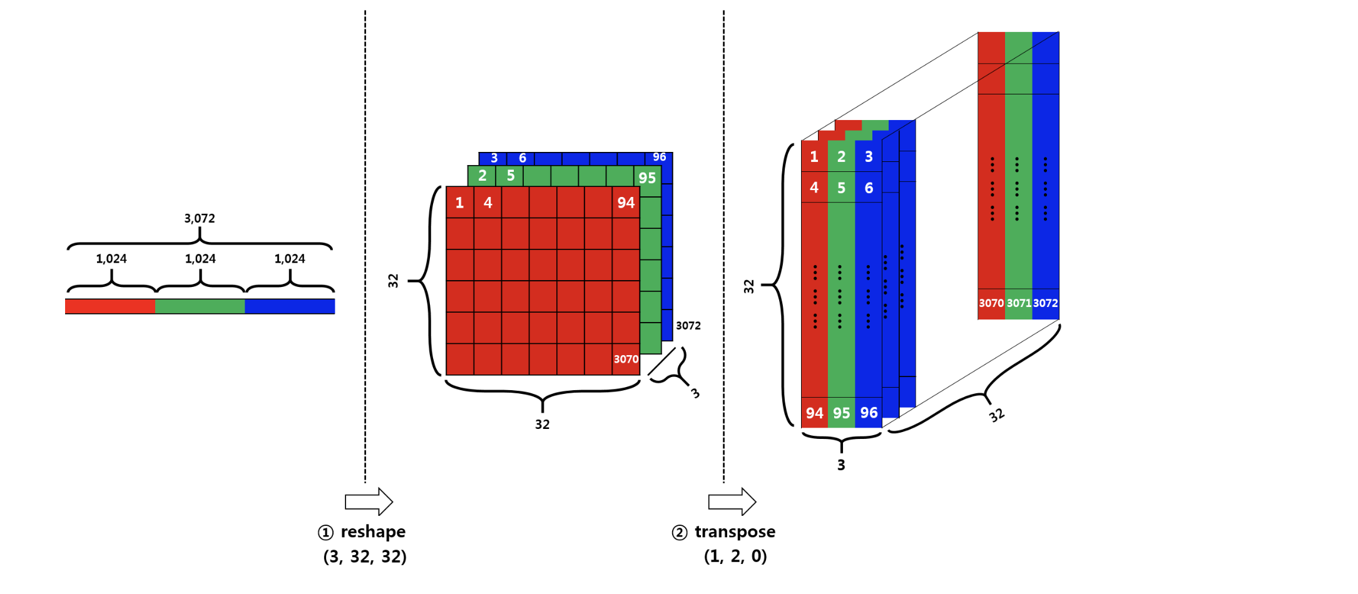
Reshaping the Data
3072 represents an color image of 32x32 pixels
In order to feed the color image to the CNN, image data should be either (width x height x num_channel) or (num_channel x width x height)

Slide 9
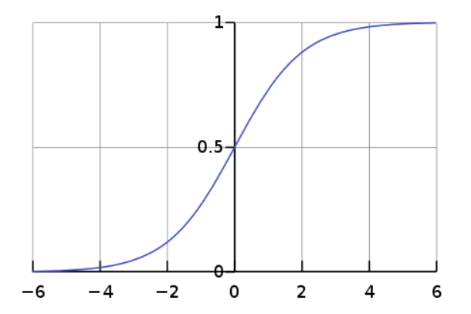
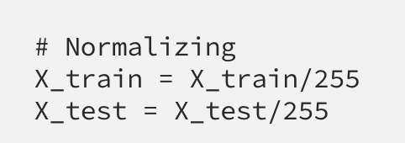
Normalizing the Data
All the pixel value are in the range 0 to 255, so our next task is to normalize the data into the range 0 to 1
. It can be done either by dividing all the pixels with the value 255 or using the ‘normalize’ command from keras library.

Slide 10
Building the Model
Convolution or Conv2D Layer
Pooling or MaxPooling2D Layer
Flatten Layer
Dense Layer

Slide 11
Compiling the Model
The function can be compiled using model.compile() function.
Three parameters for compiling are:
Loss function
Optimizer
Metrics

Slide 12
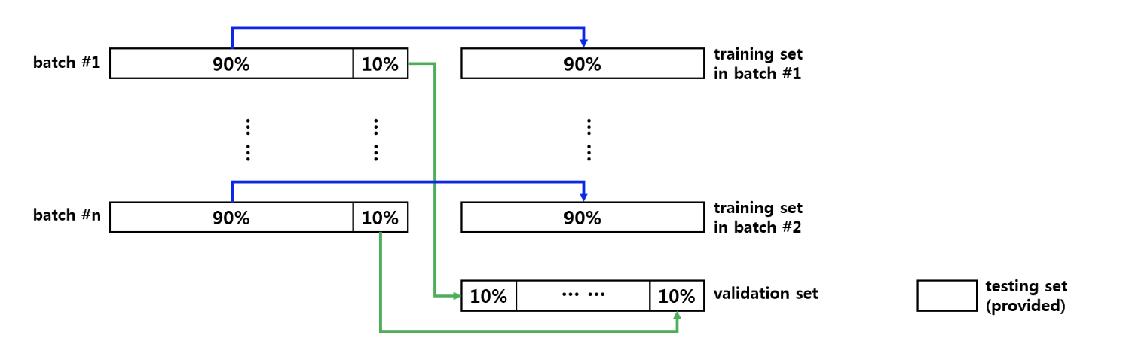
Training The Model
This function takes the training and validation data in order to fit our model.
We work on the strategy that 10% of the training data is allocate to the validation data.
Training of the model is done by using model.fit() function.

Slide 13
The Architecture:
Architecture / Model 1 | Architecture / Model 2 | Architecture / Model 3
In this we have using Conv2D Layer of 32 filters, (3x3) kernel size window and ‘relu’ as activation function. In the Dense layer, 64 interconnected neuron is using and 10 neuron as the final output. “Categorical cross entropy” is used as a loss function, ”Adam” as optimizer and number of iteration done is 20 | Here we increase the numbers of Conv2D Layer filter to 128, increase the kernel size window (4x4) and ‘relu’ as activation function. Here added dropout of 50%. In the Dense layer, number of neuron increased to 256 and 10 neuron as the final output. “Categorical cross entropy” is used as a loss function, ”Adam” as optimizer and number of iteration done is 20 | In this Model, same architecture is used as of Model 2. Here we train the model by reducing the learning rate and increase the number of iterations.

Slide 14
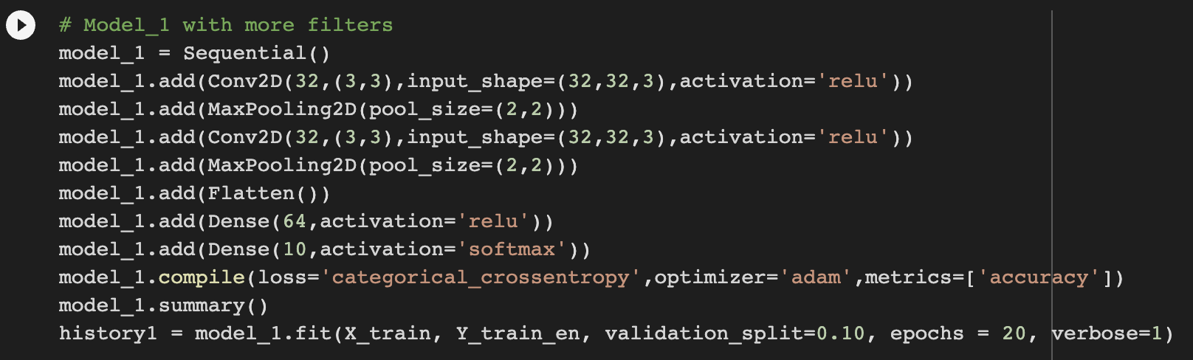
Model 1:
Model 1:

Slide 15
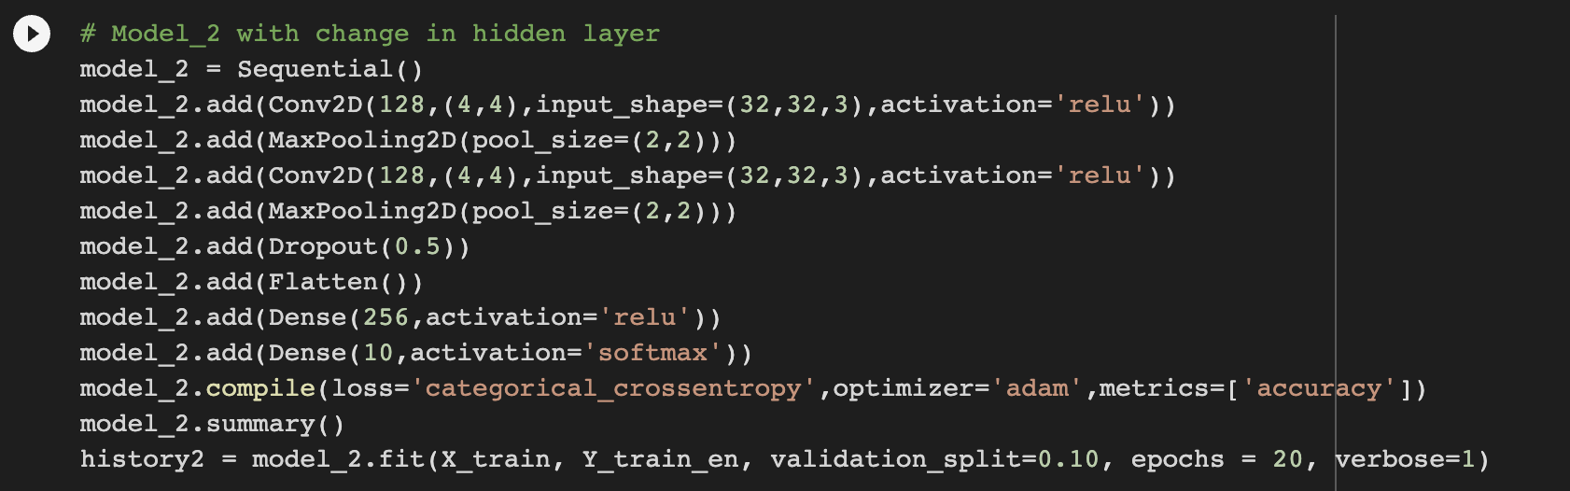
Model 2:

Slide 16
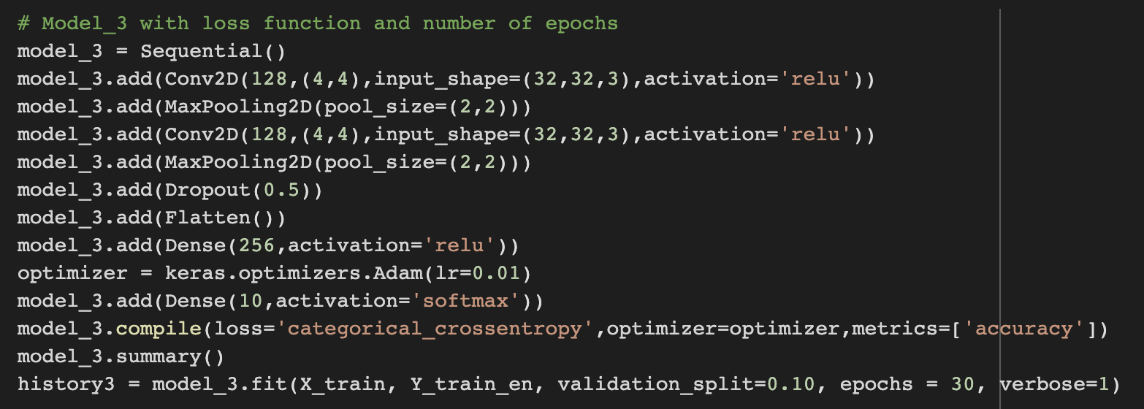
Model 3:

Slide 17
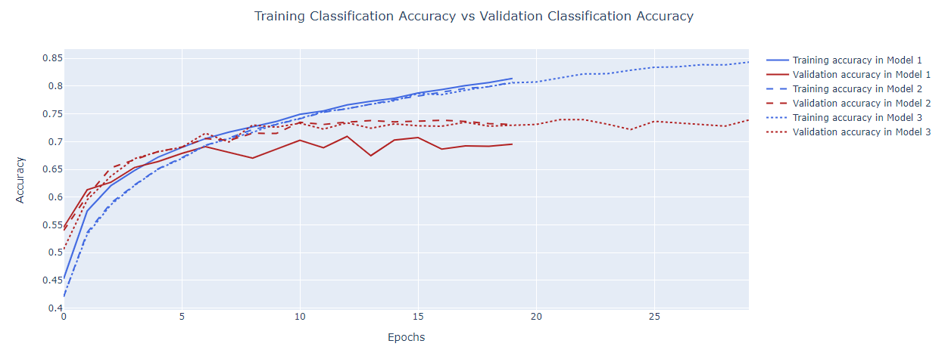
Conclusion:
Accuracy

Slide 18
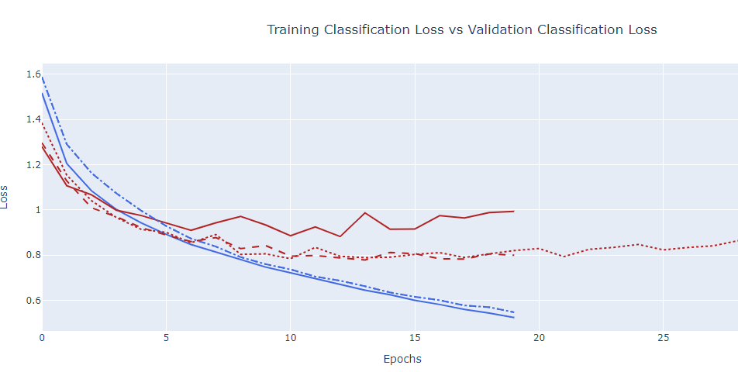
Loss

Slide 19
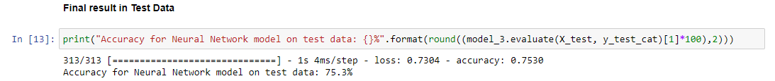
Evaluating Model with Test Data

Slide 20
Interpreting Results
In the Model 1 , We got the higher training accuracy of 81.85% compare to the other models. But it seems there is variations between training and validation accuracy of 14.25%. Thus we cannot accept the model.
Since there is a high variation between training and validation accuracy in Model 1, our next step is reduce the variation by adding dropout 50% and adding more filters in the convolution layer and also adding more neurons in the dense layer. Now the validation accuracy has improved from 66.70% to 74.08% due to reduction of validation loss from 1.09 to 0.77.
In the next Model, we continue to train the model by increasing the number of epochs and reducing the learning rate. Now the validation accuracy further increased to 76%.
After analysing the three model, by comparing the stability ,accuracy and loss, the model 3 is more preferable.
After Evaluating the model with the test data , it shows an accuracy of 75.3%

Slide 21
Reference: 1.https://youtu.be/Zi-0rlM4RDs 2.https://www.youtube.com/watch?v=7HPwo4wnJeA&feature=youtu.be 3.https://www.youtube.com/watch?v=GiIalyNjM6Q 4.https://medium.com/0xcode/using-a-convolutional-neural-networks-cnn-to-classify-images-using-cifar-10-17f8010ff20b 5.https://devashree-madhugiri.medium.com/using-cnn-for-image-classification-on-cifar-10-dataset-7803d9f3b983

